Slide 1
GEOGRAPHUN Javascript Project
JONATHAN STRANDBERG, LOUISE CUTHBERTSON, GARETH EVANS, MAGGIE AMIN

Slide 2
The Brief!
Design an educational app that will:
allow the user to play interactive quizzes;
use the countries API;
store country data and scores in a mongoDB database.

Slide 3
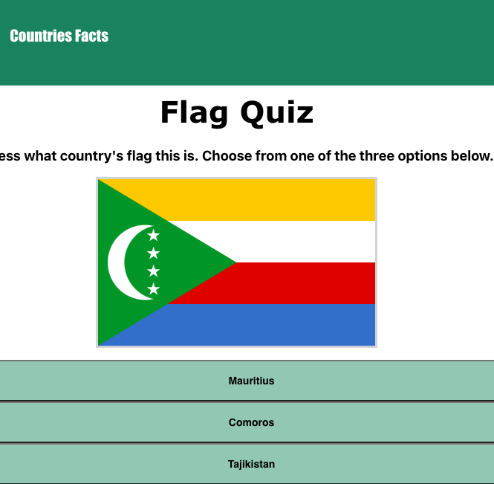
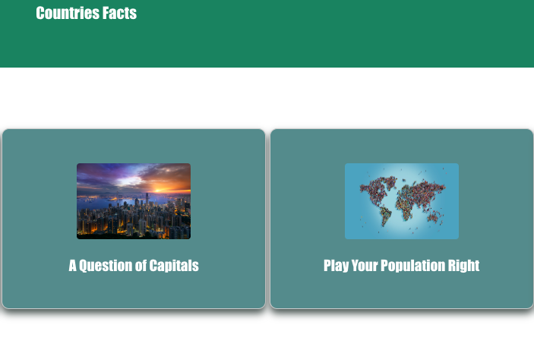
Design!
Background to project.
Functionality & Design
Initial Planning documents

Slide 4
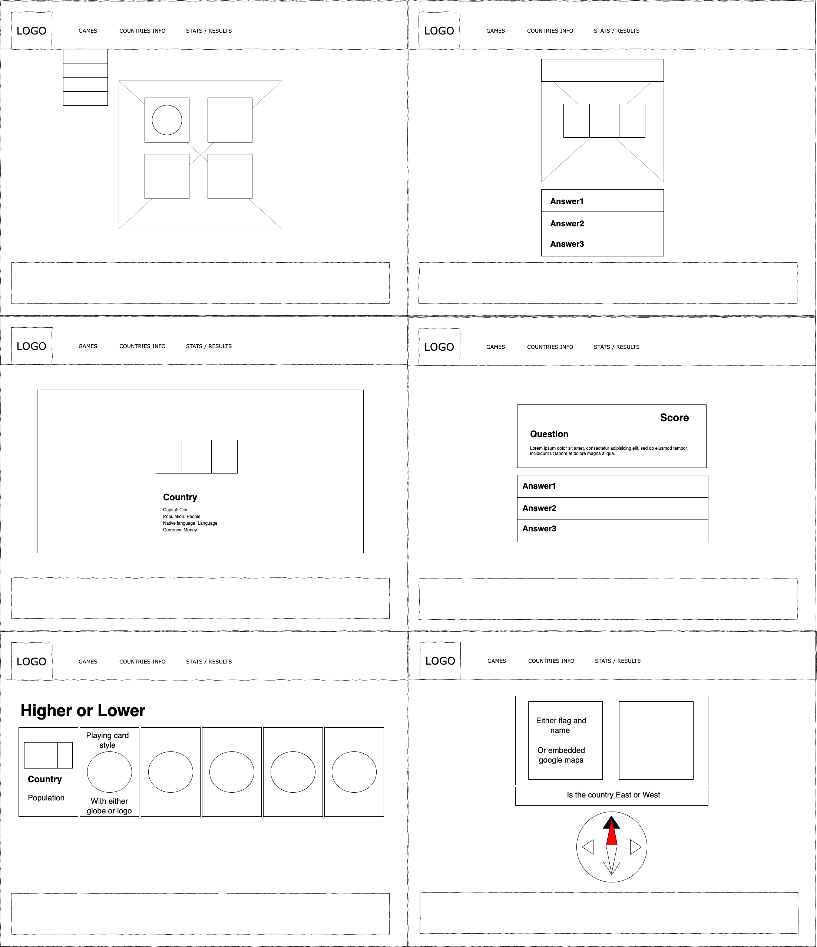
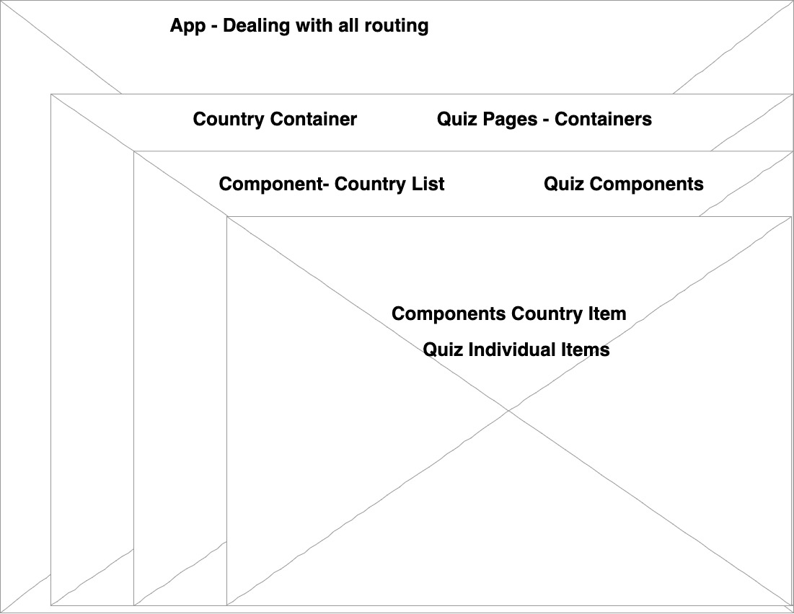
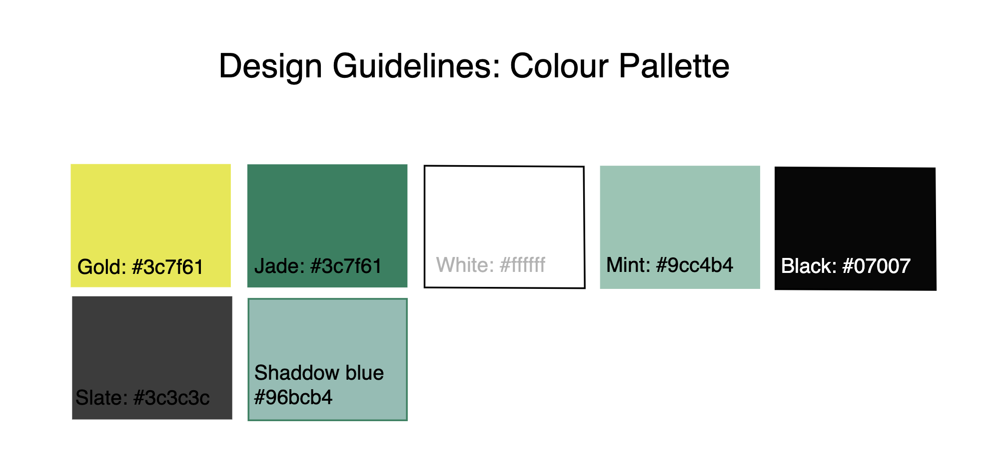
#00A36C
Williamsburg
#A21B6F3

Slide 5
THE DEMO!

Slide 6
FURTHER EXTENSIONS
Stats page for user scores etc.
Apply regional filtering to quizzes
Login & authentication to allow multiple users
Extend the range of games available

Slide 7
CHALLENGES & LESSONS LEARNED
Scope setting
Github branches
Debugging!!
Timing issues with useEffects
Pros & cons of mobbing vs. solo
TAKE BREAKS!!!

Slide 8

THANKS!
DO YOU HAVE ANY QUESTIONS?

